Slide 1
Mental Health Prediction Using Machine Learning
Arnub Datta 221-15-4726
Abu Zahed 221-15-4716
Md Amir Hamja 221-15-4784
Nurjahan Akther Mim 221-15-4782

Slide 2
TABLE OF CONTENTS
Introduction
Dataset Overview
Pre-Processing
ML models
Results Analysis
Limitations
Conclusion

Slide 3
INTRODUCTION
Mental health in workplaces is a critical issue that impacts employee productivity and well-being.
Early detection of mental health conditions can facilitate timely support and better outcomes.
This project applies machine learning techniques to predict mental health conditions based on demographic and workplace-related data.
Provide insights into factors influencing mental health and build a predictive model.

Slide 4
Dataset
Dataset Size: 1,259 entries, 27 features.
Key Features:
Demographics: Age, Gender, Country, State.
Work-related factors: Employment type, Company size, Remote work.
Mental health factors: Treatment history, Work interference, Family history.
Missing values in columns like work_interfere and state.

Slide 5
Preprocessing
Missing Values:
Imputation for fields like work_interfere.
Dropped rows for irrecoverable missing data.
Feature Encoding:
Categorical variables encoded using Label Encoding.
Example: Gender and Country.
Scaling:
Numeric features scaled to 0–1 range using MinMaxScaler for uniformity.
Data Split:
80% for training and 20% for testing to evaluate model performance.

Slide 6
Machine Learning Models
Logistic Regression
Decision Tree
Random Forest
AdaBoost
MLP Classifier
Stacking Classifier

Slide 7
Model Evaluation Metrics
Evaluation Metrics:Accuracy: Overall model correctness.
Precision: How well positive predictions are correct.
Recall: Model's ability to detect true positives.
Cross-validation: Ensures reliability and robustness across datasets.

Slide 8
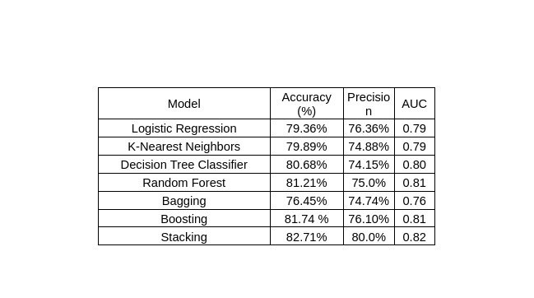
RESULT ANALYSIS

Slide 9
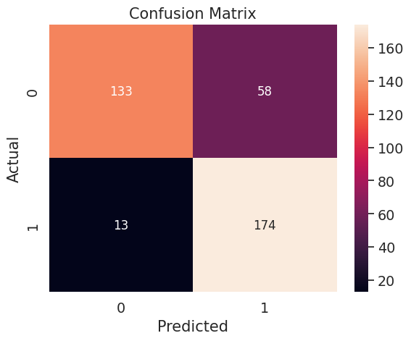
RESULT ANALYSIS

Slide 10
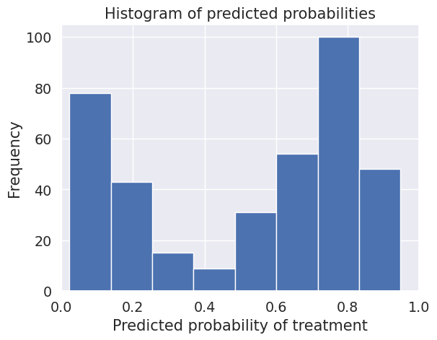
RESULT ANALYSIS Cont...

Slide 11
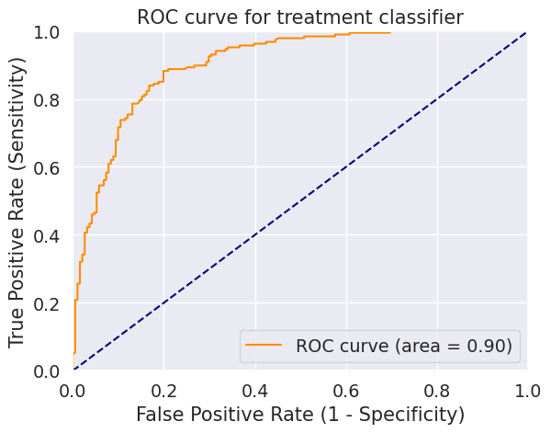
RESULT ANALYSIS Cont…

Slide 12
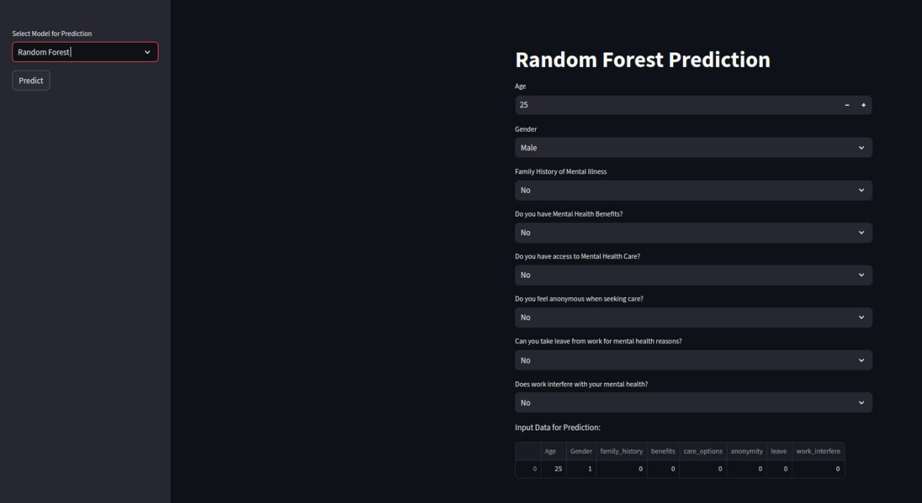
User Interface

Slide 13
Challenges and Solutions
Data Quality Issues: Missing or inconsistent responses.
Solution: Imputed missing values using appropriate statistical methods.
Imbalanced Data: Certain mental health conditions were underrepresented.
Solution: Used oversampling to balance class distribution.
Model Complexity: Advanced models like stacking required significant computation.
Solution: Hyperparameter tuning optimized performance.

Slide 14
CONCLUSION
Accurate Prediction: Machine learning models, especially the Stacking Classifier, can predict mental health conditions effectively.
Key Features: Work interference and family history are the strongest predictors of mental health outcomes.
Model Comparison: The Stacking Classifier outperformed other models in terms of accuracy and precision.
Workplace Impact: Early predictions can help in providing timely mental health support in workplaces.
Future Scope: The model can be enhanced with real-time data and larger datasets for improved accuracy.

Slide 15
THANK YOU!

